Slide 1
Plotting in Matlab
Week 8
Day 30-31

Slide 2
Plotting Data: Matlab Syntax
Matlab has easy and powerful data plotting abilities!
Sample plotting script to illustrate necessary syntax:
% “figure” creates a plot (Matlab can make more than one using ref# argument)
figure(1)
% “hold on” locks one plot as active to plot multiple graphs on same plot
hold on
% plot (x,y) where x & y are arrays of same size containing x & y values
plot(x,y,'LineWidth',4, 'LineStyle', '-' , 'Color' , 'Red')
% additional optional arguments for plot control appearance
% xlabel, ylabel, title, legend, grid add corresponding elements to a plot
xlabel('x-axis name', 'FontSize', 20, 'FontName', 'Arial')
ylabel('y-axis name', 'FontSize', 24, 'FontName', 'Times New Roman')
title ( 'title for plot', 'FontSize', 28, 'FontName', 'Arial')
legend('legend1')
grid('on')
% hold off removes control lock from the current plot so another can be done
hold off

Slide 3
In-Class Exercise #2: Array Math & Plotting
Use a Matlab script to create an array of x with values from 0 to 10 with a step size of 0.5. Calculate a corresponding array, y = x³.
Add code to your script above to plot y vs. x using good graph technique (axis labels, title, etc.).
Note that the array-making shortcut and array mathematical operators eliminate the need for most of the For-Next loops we wrote in VBA!

Slide 4
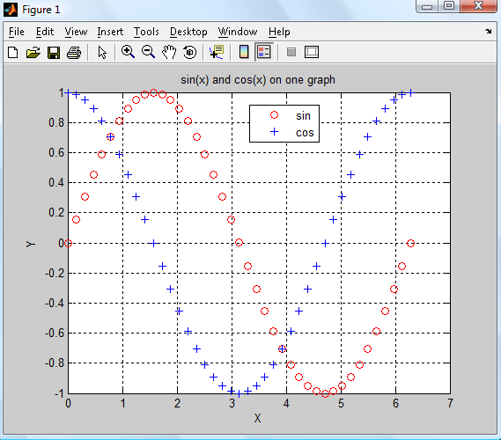
In-Class Exercise #3 - Plotting
Need to create X and Y 1D arrays of the same length, and to pass it to plot(X,Y) (see details typing in command window: doc plot)
%This is a code illustrating simple plotting technique based on sin(x) and cos(x) ranging from 0 to 2*pi
clc; clear all; close all
X=0:2*pi/40:2*pi;
Y=sin(X);
plot(X,Y,'ro')
hold on
Y=cos(X);
plot(X,Y,'b+')
legend('sin','cos')
xlabel('X'); ylabel('Y');
title('sin(x) and cos(x) on one graph')
grid on

Slide 5
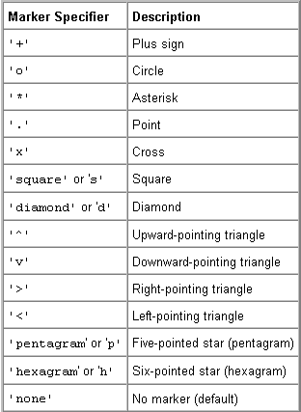
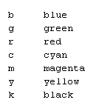
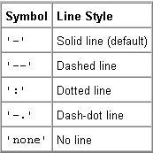
Format String Codes
To format a plot, use the syntax: plot(x,y,s) where x & y are the arrays of data and s is a string of text defining the format…

Slide 6
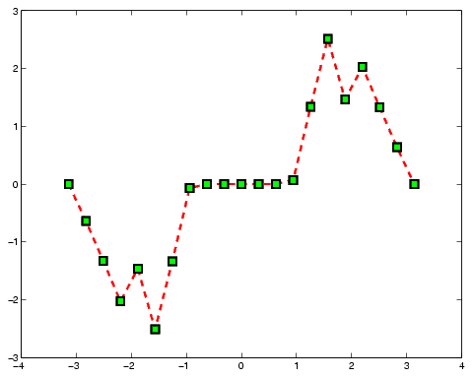
Related plot functions
‘LineWidth’, 'MarkerSize‘, 'MarkerFaceColor', title, xlabel, ylabel, legend, grid on , hold on, figure - self explanatory, see examples
x = -pi:pi/10:pi;
y = tan(sin(x)) - sin(tan(x));
plot(x,y,'--rs','LineWidth',2,...
'MarkerEdgeColor','k',...
'MarkerFaceColor','g',...
'MarkerSize',10)

Slide 7
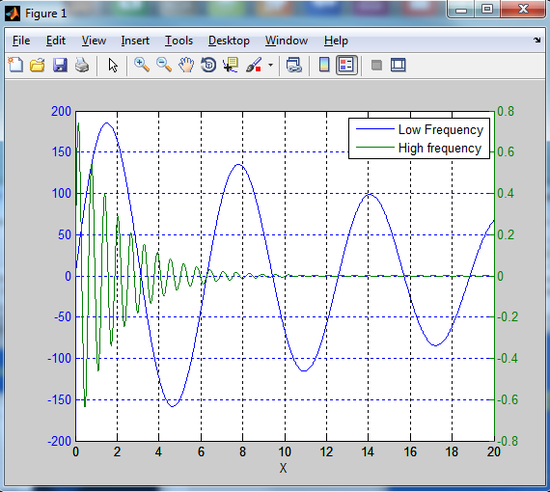
In-Class Exercise #4 Plotting: Two Vertical (y) Axes
close all; clear all; clc
x = [0:0.01:20];
y1 = 200*exp(-0.05*x).*sin(x);
y2 = 0.8*exp(-0.5*x).*sin(10*x);
plotyy(x,y1,x,y2);
legend('Low Frequency','High frequency')
xlabel('X');
grid on

Slide 8
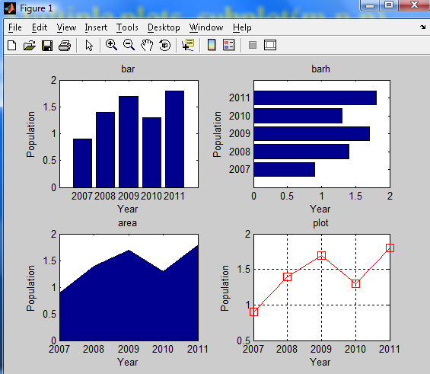
In-Class Exercise #5 Multiple plots. subplot(m,n,p)
subplot(m,n,p) - divides the current figure into rectangular panes that are numbered row-wise.
n- number of horizontal lines,
m- number of vertical lines,
p – number of current pane

Slide 9
In-Class Exercise #5 Multiple plots using subplot(m,n,p)
year=[2007:2011]; %note: increment defaults to 1 if omitted
pop=[0.9 1.4 1.7 1.3 1.8];
subplot(2,2,1)
bar(year,pop);
title('bar'); xlabel('Year'); ylabel('Population')
subplot(2,2,2);
barh(year,pop);
title('barh'); xlabel('Year'); ylabel('Population')
subplot(2,2,3);
area(year,pop);
title('area'); xlabel('Year'); ylabel('Population')
subplot(2,2,4);
plot(year,pop,'-rs','MarkerSize',10);
title('line'); xlabel('Year'); label('Population'); grid on

Slide 10
In-Class Exercise #6: Multiple Plots
Plot the following four functions (note that some are in polar coordinates) on four subplots within a single figure window (use subplot(2,2,i))
x = cos³ t, y = sin³ t
r = 2 + cos θ
r = 4 cos θ - 1 / cos θ
r = e^{θ}
Use Matlab help to find how to make polar plots
Make sure all your plots are presentable: titles, axis labels, etc. Use enough points to make the plots appear relatively smooth

